Slide 1
Computer Architecture: Memory Busses
Dr. Colin O’Flynn

Slide 2
Lectures
How does a program run on a machine?
How do you compile from high-level code to machine code?
How does the machine run? (Control Flow)
How does the machine store data?
How does the machine interface using buses?
What does it mean to have “allowed” memory?
How does the machine speed up data access?

Slide 3
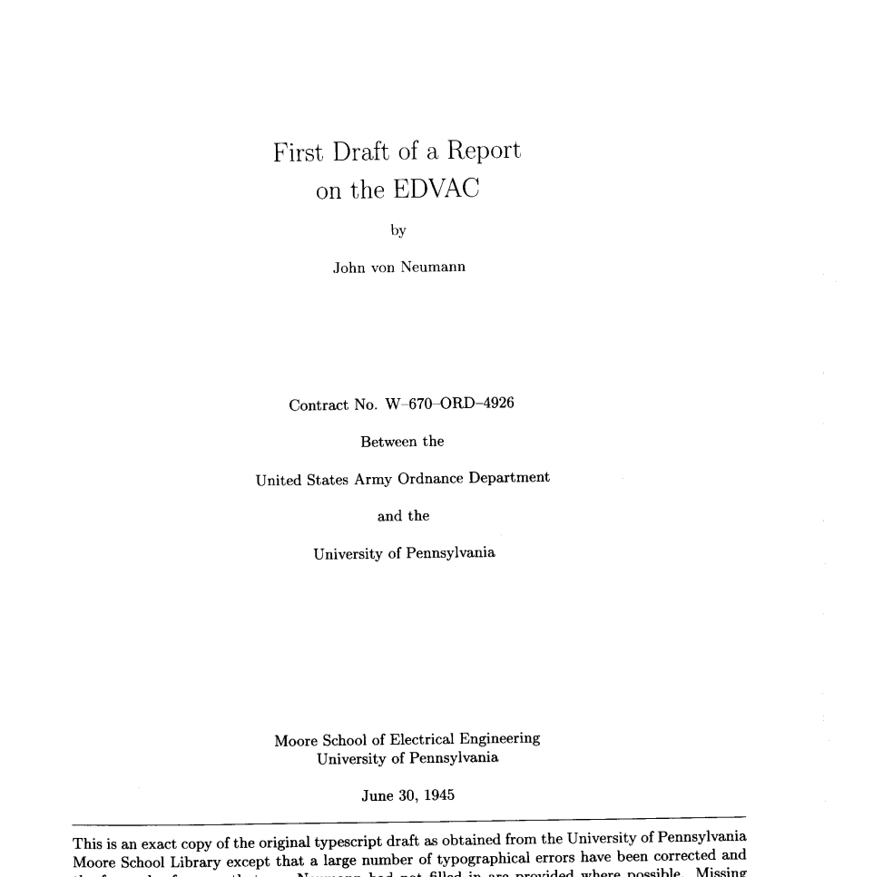
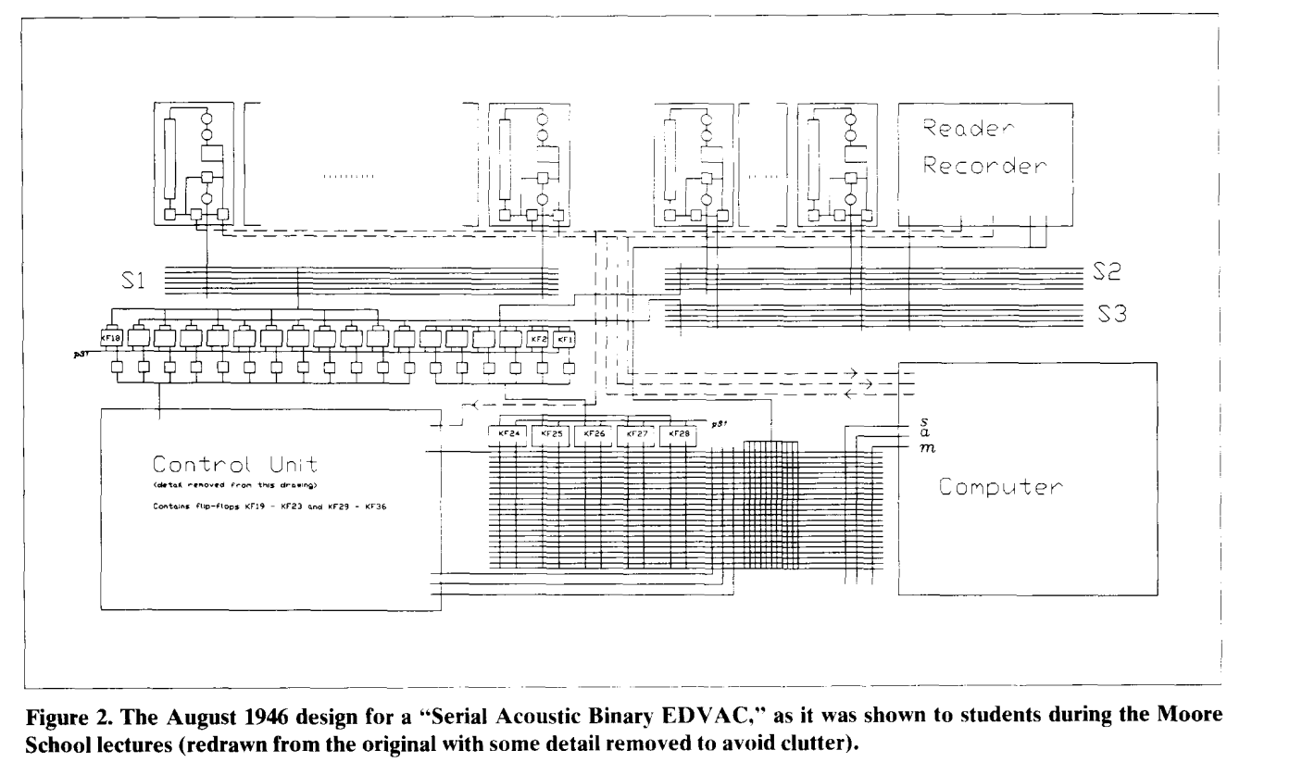
https://web2.qatar.cmu.edu/~mhhammou/15346-s13/resources/OriginsOfComputers/Origins%20Fate%20of%20EDVAC.pdf

Slide 4
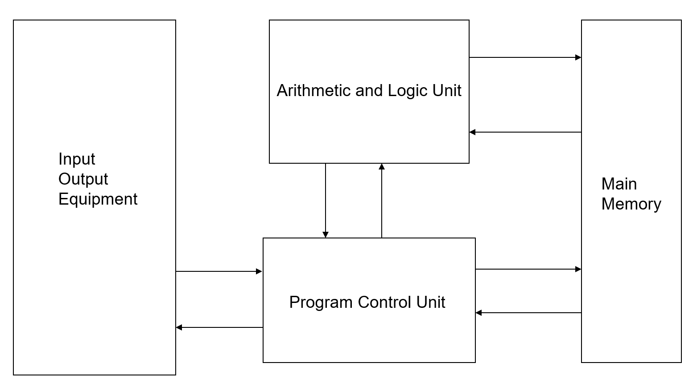
The von Neumann computer

Slide 5
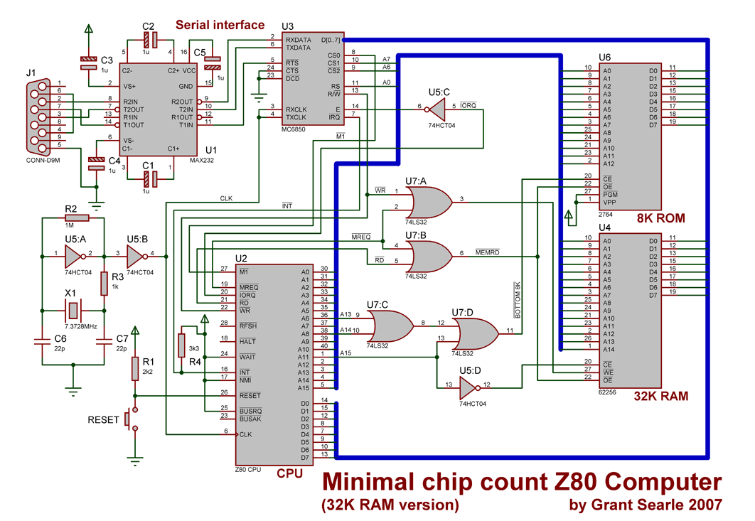
What is a bus actually?
(Go to next slide for bigger version)
https://www.madexp.it/2018/02/26/z80-single-board-computer/

Slide 7
Note shared signals:
ROM
Address
Even this simple system has a “memory map” – note use of A15 to select
Data
Some “extra stuff”
Note U3 also on the bus!
RAM

Slide 8
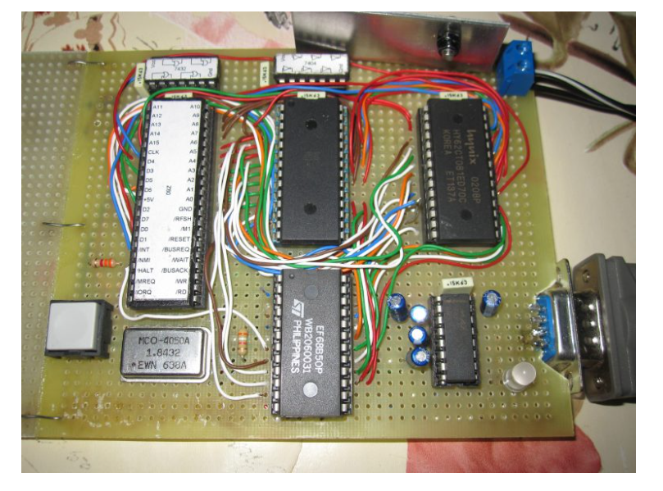
Physical Implementation

Slide 9
Advantages of Buses
I/O Device
I/O Device
I/O Device
Processer
Memory
Versatility:
New devices can be added easily
Peripherals can be moved between computer systems that use the same bus standard
Low Cost:
A single set of wires is shared in multiple ways

Slide 10
Disadvantages of Buses
I/O Device
I/O Device
I/O Device
Processer
Memory
It creates a communication bottleneck
The bandwidth of that bus can limit the maximum I/O throughput
The maximum bus speed is largely limited by:
The length of the bus
The number of devices on the bus
The need to support a range of devices with:
Widely varying latencies
Widely varying data transfer rates

Slide 11
Bus Controller vs. Peripheral
Controller issues command
Bus
Controller
Bus
Peripheral
Data can go either way
A bus transaction includes two parts:
Issuing the command (and address) – request
Transferring the data – action
Controller is the one who starts the bus transaction by:
issuing the command (and address)
Peripheral is the one who responds to the address by:
Sending data to the controller if the controller ask for data
Receiving data from the controller if the controller wants to send data

Slide 12
Bus Organization: One Bus
Backplane Bus
Processor
Memory
I/O Devices
A single bus (the backplane bus) is used for:
Processor to memory communication
Communication between I/O devices and memory
Advantages: Simple and low cost
Disadvantages: slow and the bus can become a major bottleneck
Example: IBM PC - AT

Slide 13
Bus Organization: Two Buses
Processor Memory Bus
Processor
Memory
Bus
Adaptor
Bus
Adaptor
Bus
Adaptor
I/O
Bus
I/O
Bus
I/O
Bus
I/O buses tap into the processor-memory bus via bus adaptors:
Processor-memory bus: mainly for processor-memory traffic
I/O buses: provide expansion slots for I/O devices
Apple Macintosh-II
NuBus: Processor, memory, and a few selected I/O devices
SCCI Bus: the rest of the I/O devices

Slide 14
Bus Organization: Three Busses
Processor Memory Bus
Processor
Memory
Bus
Adaptor
Backside
Cache bus
Bus
Adaptor
I/O Bus
L2 Cache
Bus
Adaptor
I/O Bus
A small number of backplane buses tap into the processor-memory bus
Processor-memory bus is only used for processor-memory traffic
I/O buses are connected to the backplane bus
Advantage: loading on the processor bus is greatly reduced

Slide 15
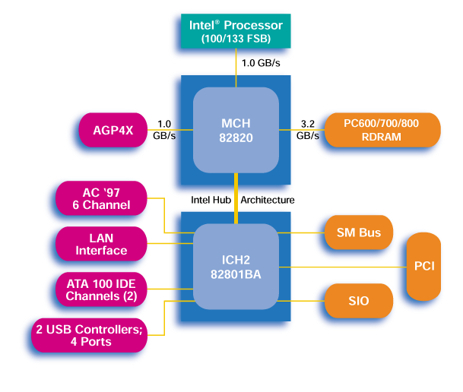
e.g., Old Pentium II/III Organization:

Slide 16
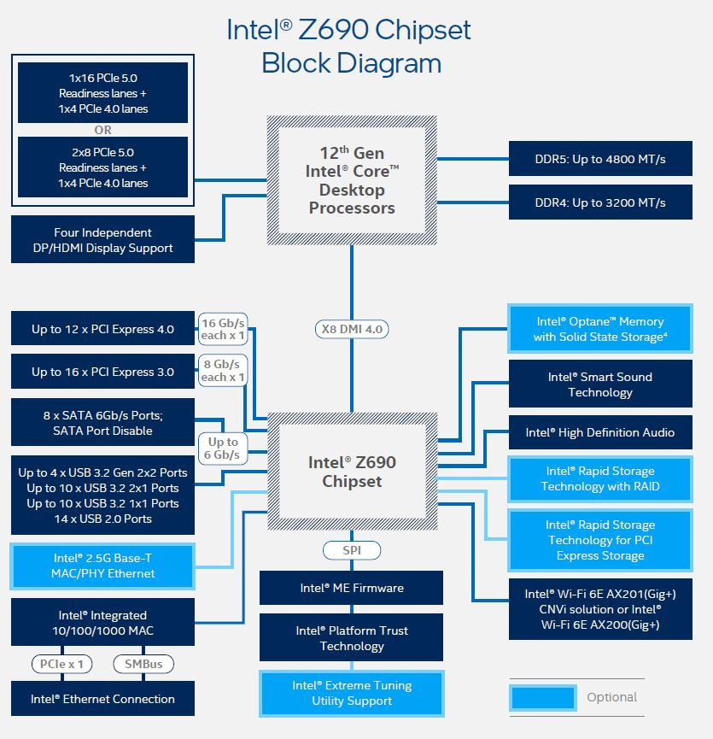
e.g., Newer Gen
More functions now integrated into the main chip.
External busses are always slower…

Slide 17
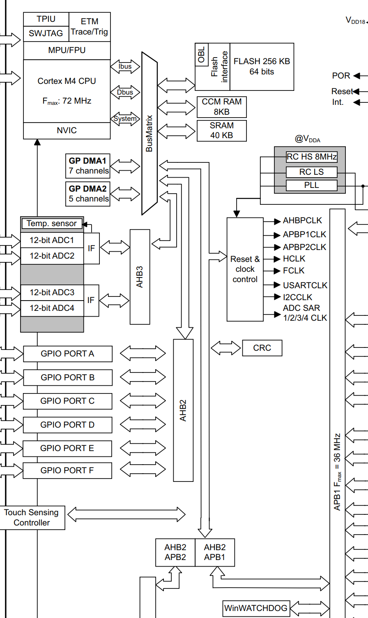
Embedded Processor Busses
Busses serve similar purposes even if not external.
Standard bus interface makes it easy to add/remove blocks

Slide 18
Common On-Chip Bus Protocols
AHB (Advanced High-performance Bus)
Large bus widths supported, advanced features like bursts
APB (Advanced Peripheral Bus)
Similar to AHBP but simpler signaling, designed for low-frequency peripherals
AXI (Advanced eXtensible Interface)
Higher performance than AHB – allows more features like multiple “outstanding transfers”

Slide 19
Transfer Modes in Busses
Naïve Bus Protocol Implementation (hope data is ready)
Controller
Peripheral
time

Slide 20
Transfer Modes in Busses
Realistic Bus Protocol Implementation (acknowledge signal)
Controller
Peripheral
time

Slide 21
Transfer Modes in Busses
Avoiding Stalls: Outstanding Transactions
Controller
Peripheral #1
Peripheral #2
time

Slide 22
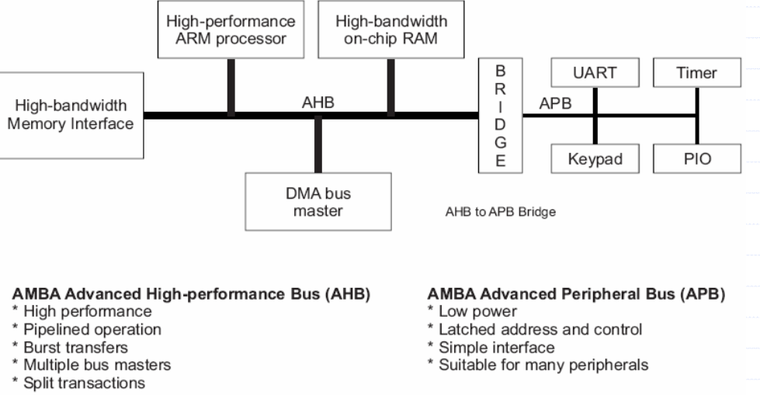
AHB Signaling

Slide 23
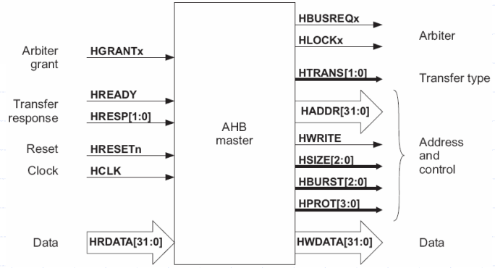
AHB Signals

Slide 24
Typical Internal Bus Signaling
Not “pin limited”
Note separate input & output data lines
Common to have many control signals

Slide 25
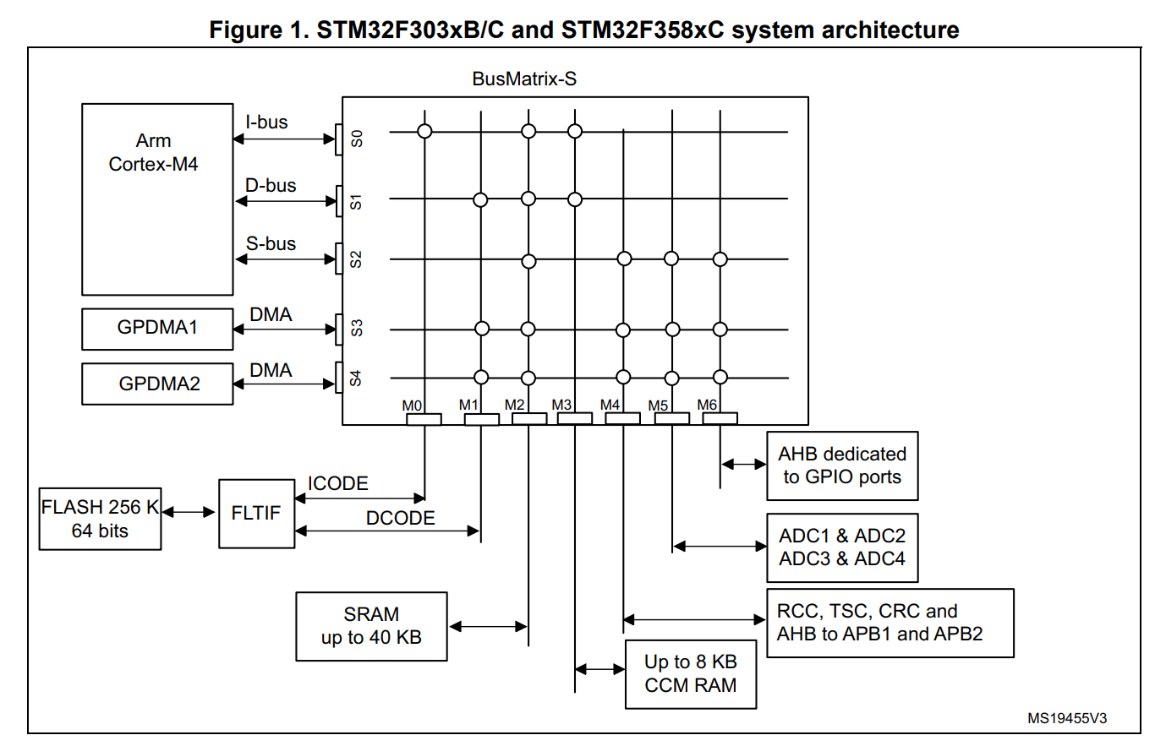
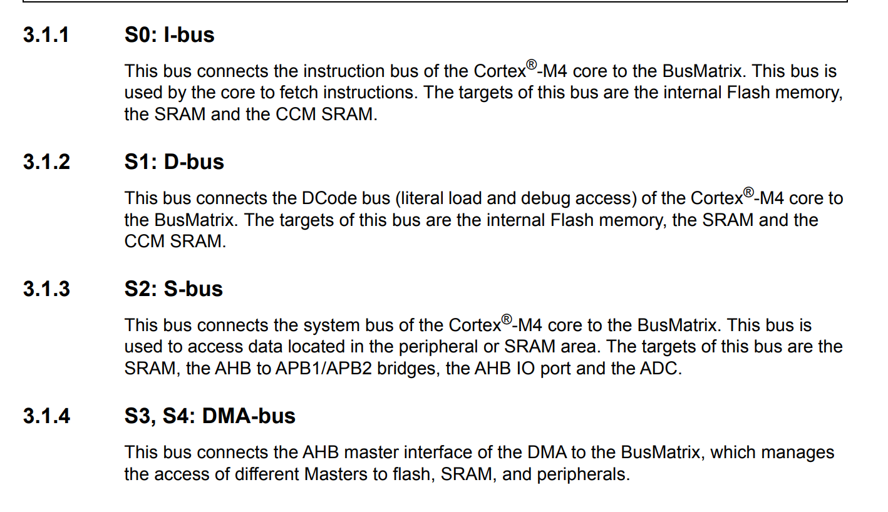
e.g., STM32F3 Bus Matrix

Slide 26
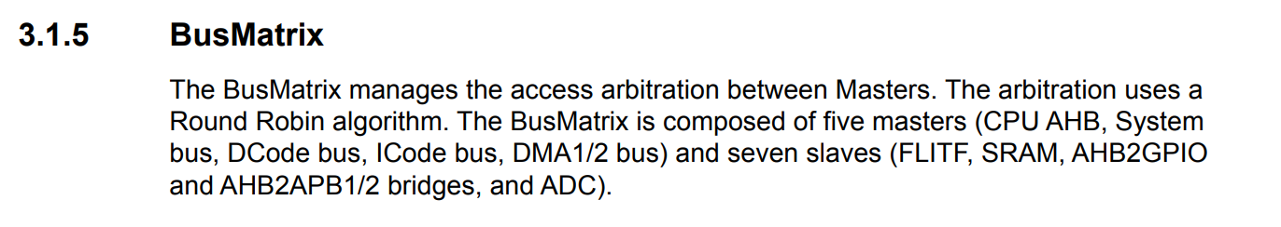
Bus Arbitration?
A bus may have more than one controller:
Multi-core processors
Systems with e.g., a high-performance & low-performance processor
Special blocks such as DMA
Bus arbitration determines who owns the bus, various algorithms used, but e.g., STM32F3:

Slide 27
Round Robin
DMA2
Core: I-Bus
DMA1
Core: D-Bus

Slide 28
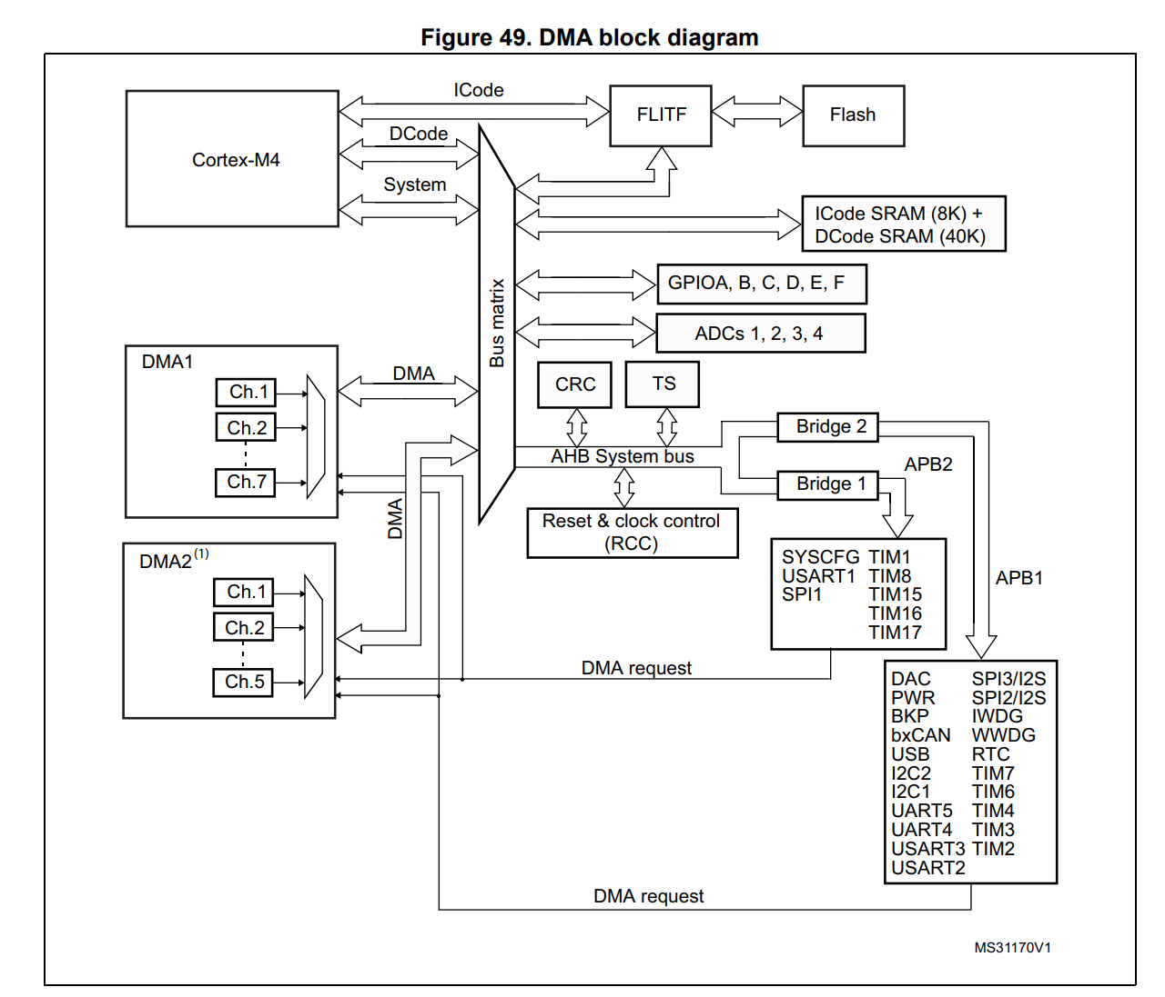
DMA
DMA is another bus controller which can read/write from Memory & Peripherals.
Can be triggered by events such as:
ADC complete
Packet received (USB, Ethernet, etc)

Slide 29
DMA Keeps the CPU Free
Examples of common DMA Usage:
Copy large blocks of data
Automatically receive incoming data to a buffer
Take a transmit buffer, read a new “chunk” of data when the peripheral is ready
Large Buffer (>1000 bytes)
USB Packet (64 bytes)
USB Packet (64 bytes)

Slide 30
DMA Usage
DMA is one of the most powerful features of microcontrollers you can use with high I/O requirements.
Many programs are only possible with DMA, for example:
USB Microphone would have:
DMA from ADC→ Memory
DMA from Memory → USB
Microcontroller does “housekeeping” keeping signals alive
Normally required for sampling & high-throughput communications

Slide 31
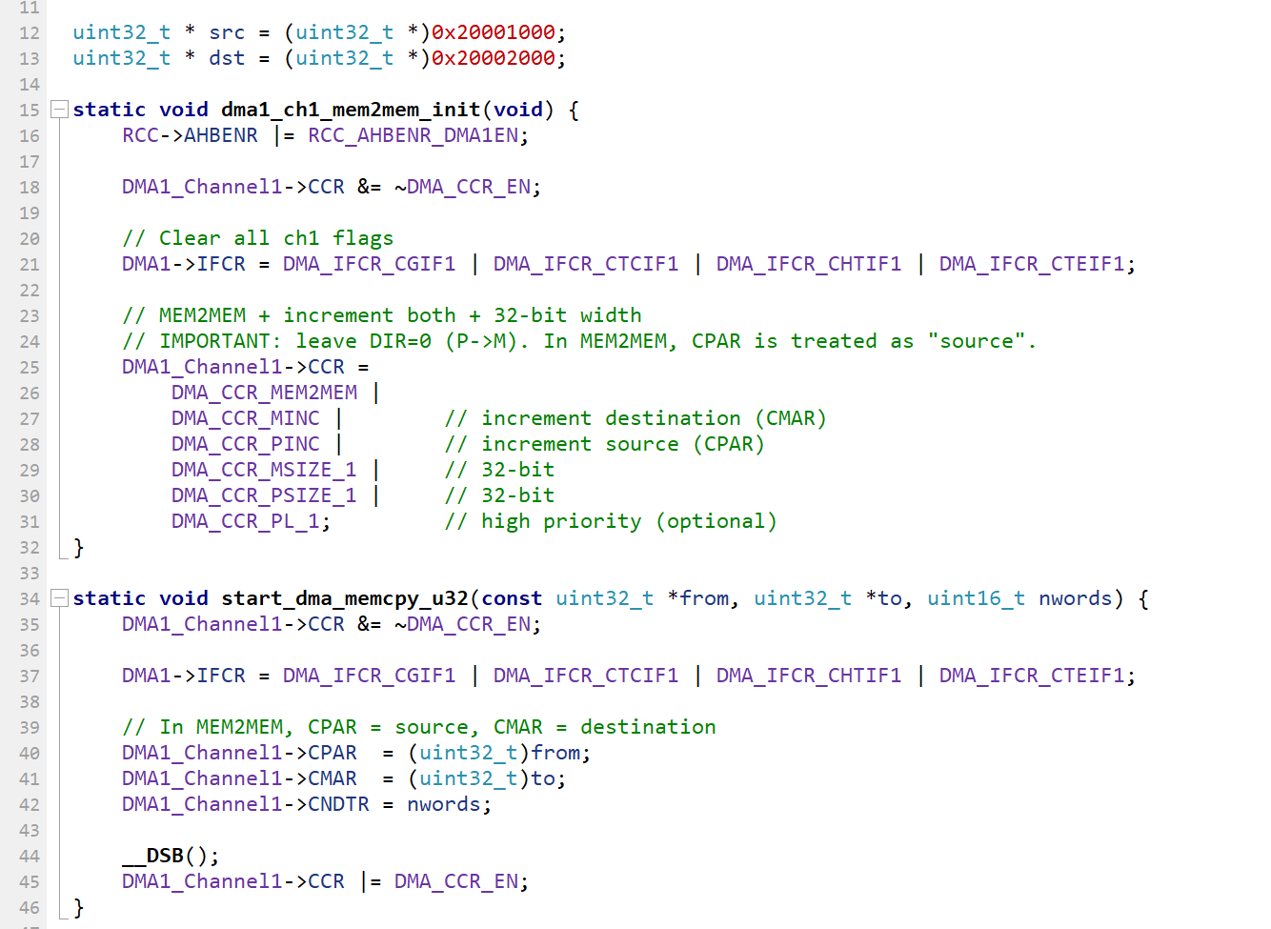
e.g., DMA Demo

Slide 32
Sidenote: Data Synchronization Barrier (DSB)
Note the Data Synchronization Barrier (DSB)
Technically not needed as peripheral memory should not be reordered
But if you were writing something to e.g., memory being read from before enabling may still want that (ensures memory consistency)

Slide 33
DMA Usage: High-Level
Set source & destination addresses
Set if either address should automatically increment (normally not incrementing for peripherals, but do increment for memory)
Set word size (e.g., normally 32 bits)
Set number of words to transfer
Watch out for Bytes/Words confusion!
Enable & let it go!

Slide 34
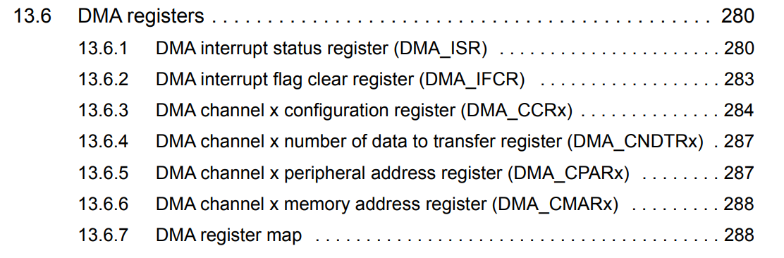
STM32F3 DMA Hints
CPAR / CMAR can be source/dest depending on “DIR” bit in CCR
Watch out that not all memory addresses are accessible (see next topic on TCM/CCM)

Slide 35
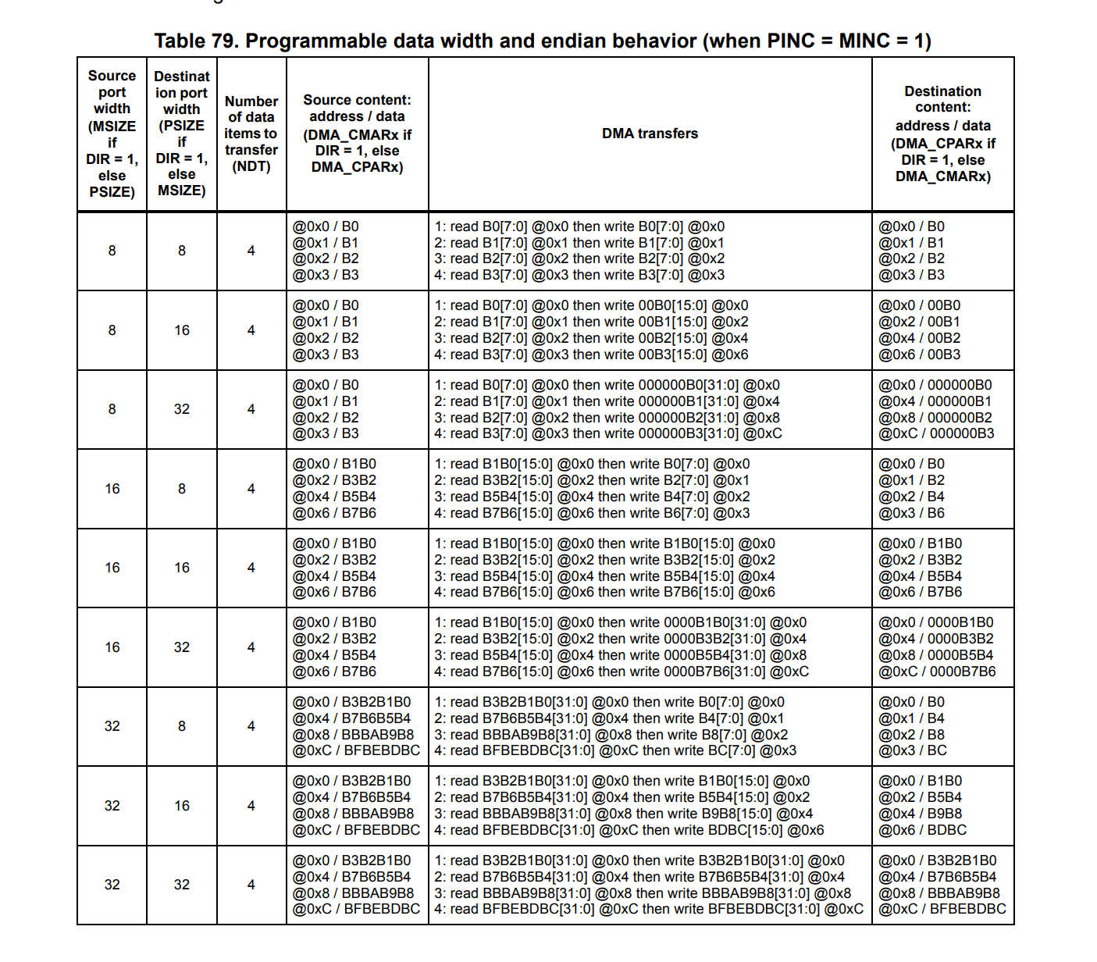
STM32F3: DMA Data Width & Alignments
Many DMA problems (on all devices) are related to data widths.
If not transferring the same data width, need to be very careful about order/alignment.
E.g., Table at right is from ST32F303 Ref Manual

Slide 36
DMA for Data Packing
Sometimes you use this on purpose:
8-bit or 16-bit data coming in from a peripheral
You want this packed into 32-bit array for memory efficiency
DMA can do that automatically!

Slide 37
Core Coupled Memory (CCM) Closely Coupled Memory (CCM) Tightly Coupled Memory (TCM)
All of those have the same idea – keep some special RAM that is even faster than system memory.
Different than a cache as this is separate memory, not mirroring main memory.
TCM is present in higher-performance cores, may bypass matrix entirely.
Arm CCM uses matrix, but is not accessible to DMA as only for CPU usage.

Slide 39
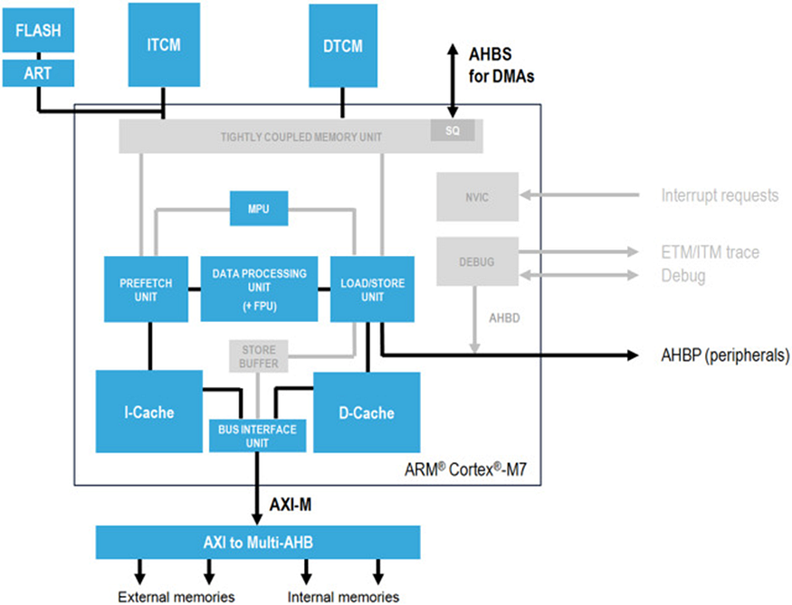
e.g., Cortex-M7 TCM Blocks

Slide 40
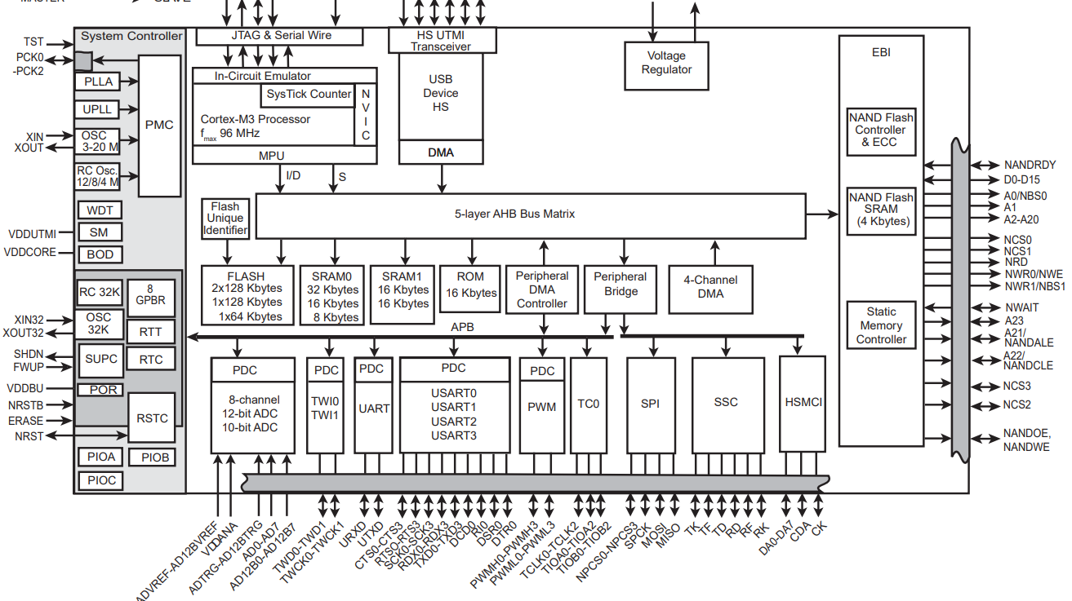
Simple External Busses: SRAM
https://ww1.microchip.com/downloads/en/DeviceDoc/Atmel-6430-32-bit-Cortex-M3-Microcontroller-SAM3U4-SAM3U2-SAM3U1_Datasheet.pdf

Slide 41
Synchronous Bus
Synchronous buses will have a clock
All data & control signals only read on the clock edge
Normally strict timing requirements
Many internal busses are synchronous (e.g., AHB)
DDR Memory is an external example of synchronous bus

Slide 42
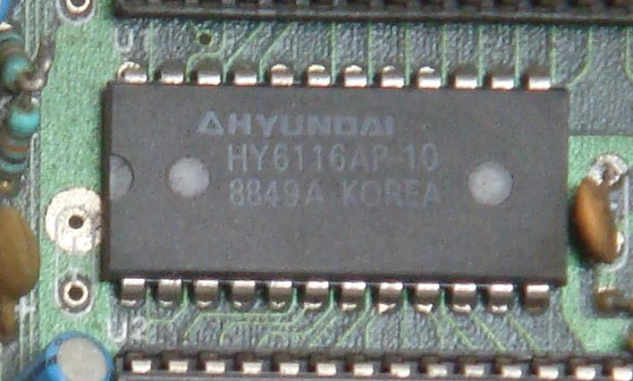
Asynchronous Bus
Control signals define when data is ready or available
Less strict timing requirements
“Normal” (older) SRAM chips, many “slower” external memories are asynchronous

Slide 43
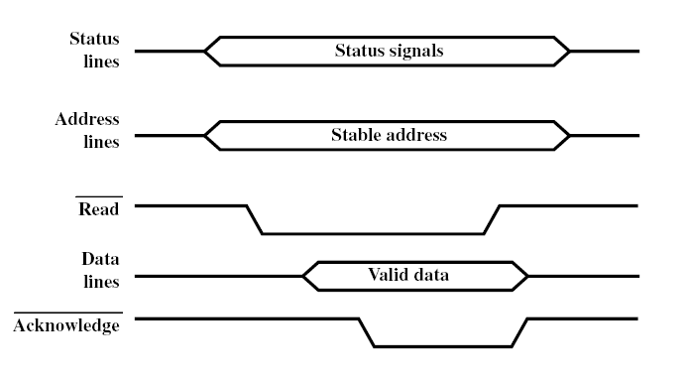
Async Read Example
Driven FROM controller
Driven FROM controller
Driven TO controller
Driven TO controller

Slide 44
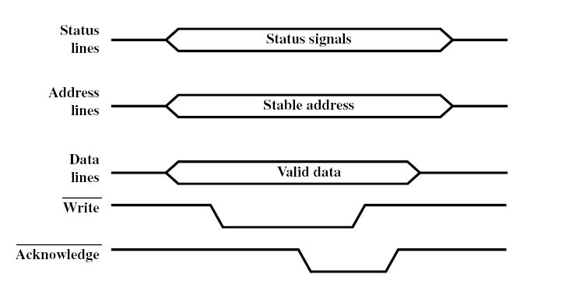
Async Write Example
Driven FROM controller
Driven FROM controller
Driven FROM controller
Driven TO controller

Slide 45
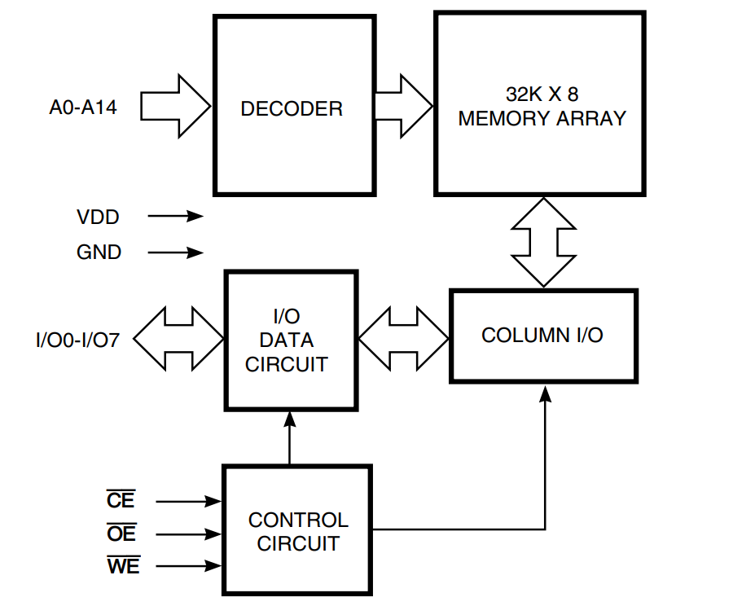
SRAM Configuration

Slide 46
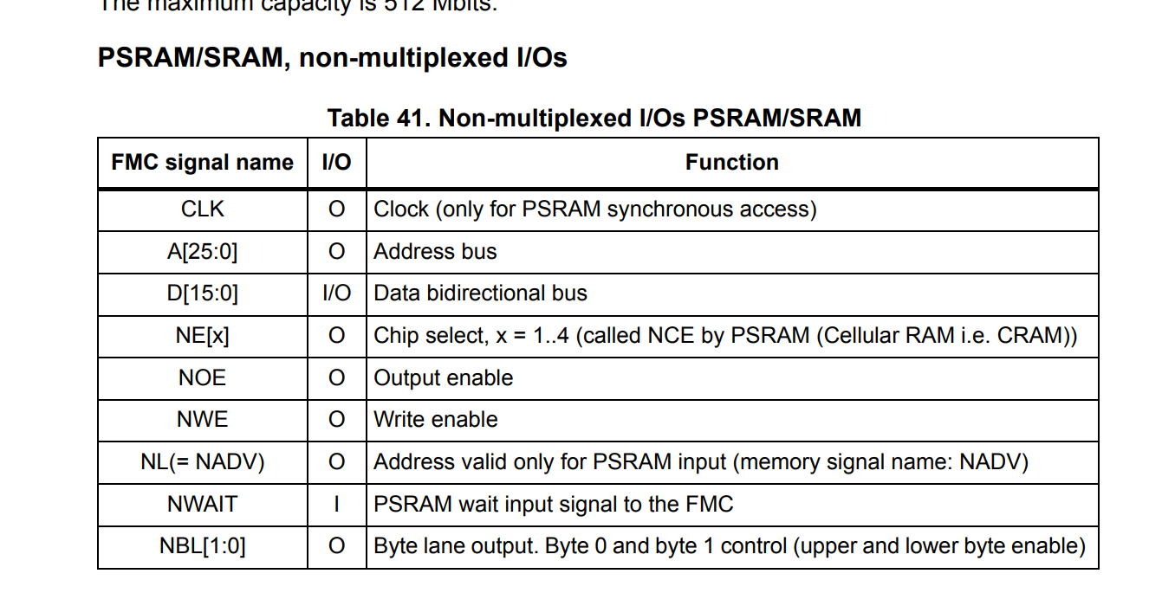
e.g., Typical SRAM Signals

Slide 47
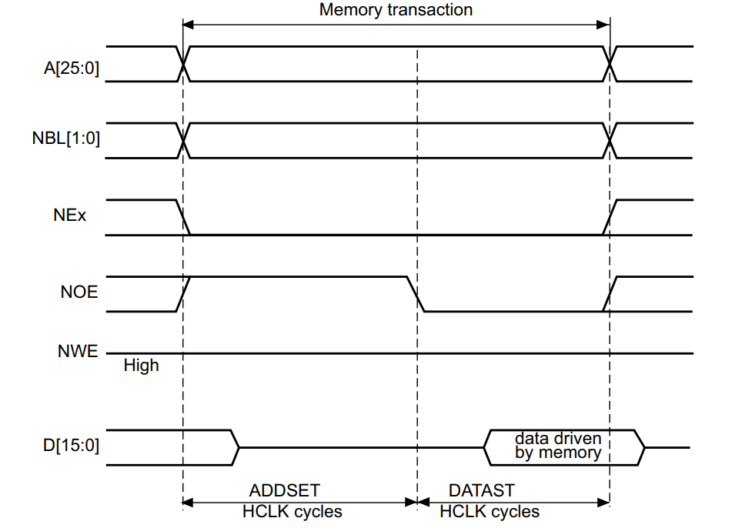
SRAM Driven from STM32F3
NOTE: No “acknowledge” signal!
This requires setting up the timing, and the SRAM responds on definite timing.

Slide 48
Interfacing to External Memory
This requires careful inspection of timing diagrams in your memory chip, comparison to microcontroller datasheet
This is one situation where you should not trust auto-generated code (AI, unknown libraries), as it is often off
Timing errors mean code might work fine initially, but has errors as temperature change

Slide 49
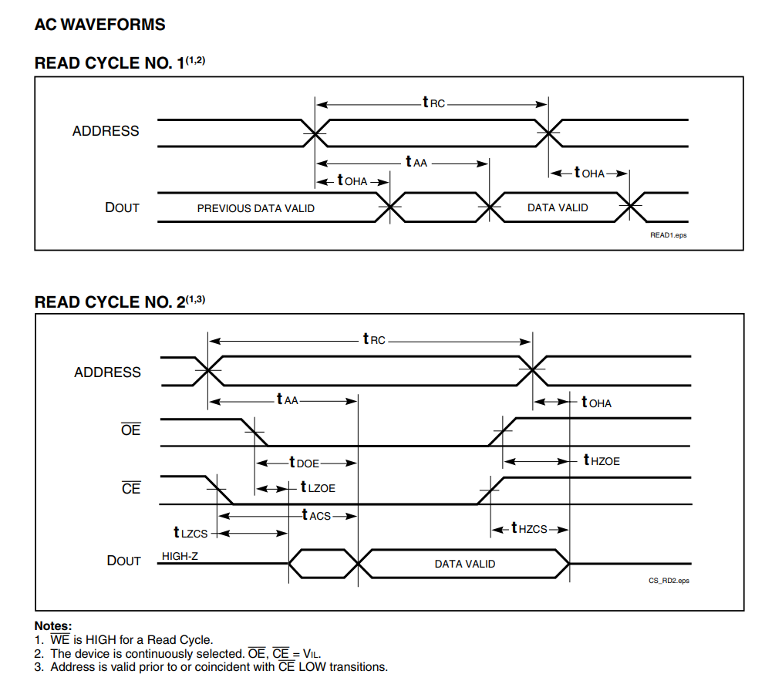
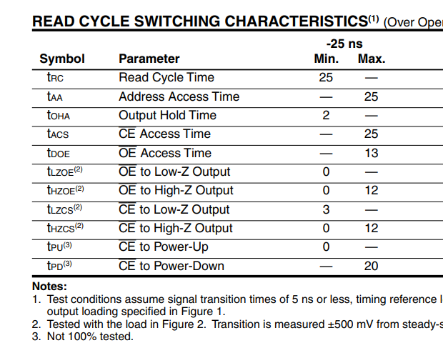
Example of SRAM (Bus) Timing Settings
https://www.issi.com/WW/pdf/62-65C256AL.pdf

Slide 50
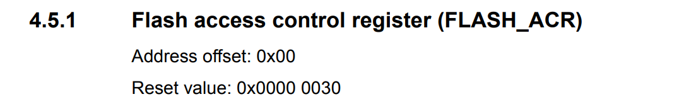
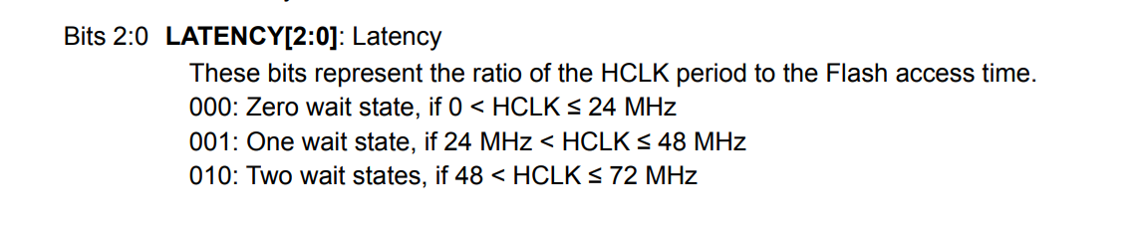
Bus Wait-States
It is common that busses support wait states
You may need to configure wait states if memory access is slower than the bus is running.

Slide 51
Busses & Performance
System performance is often limited by bus performance
E.g., processor runs at 72 MHz..but if need 2 wait-states between every FLASH access:
Naïve reading of flash in sequence slows things down
Changes to architecture of memory & caches improve that (future topics)
Avoiding wait states can be difficult in practice!
Multiple busses can greatly improve performance.

Slide 52
Careful Memory Management
e.g., Imagine DMA1 from ADC1 to SRAM
What else can happen at the same time?

Slide 53
Summary: Memory Busses
Busses are collection of wires, on-chip or off-chip
Typically we have multiple busses with some buffer/interconnect to provide both high & low performance busses, or to avoid needing to wait for other devices.
Split transactions and bus arbitration allow busses to be shared among controllers
Direct Memory Access (DMA) controller is an extremely powerful part of the microcontroller
May need to manage wait-states & timing to deal with different speed interfaces

